Slide 1
A Survey of South American Lizards Biodiversity and Ecological

Slide 2
Iguanidae This family includes the iconic Green Iguana (Iguana iguana), which is one of the
The Green Iguana is one of the most wellknown lizards in the region. Iguanidae includes a variety of species.

Slide 3
Teiidae The Teiidae family is commonly referred to as "whiptails" or "racerunners" These
Teiidae, commonly known as whiptails or racerunners, is a family of lizards.

Slide 4
Gymnophthalmidae This family is composed of small, slender lizards often found in forested
Gymnophthalmidae: This family is composed of small, slender lizards often found in forested regions. They are characterized by their reduced limbs and elongated bodies, and they play essential roles in insect control within their ecosystems.

Slide 5
Gekkonidae Geckos are representatives of the Gekkonidae family in South America These
Geckos are nocturnal lizards found in certain parts of South America.

Slide 6
Sphaerodactylidae The Sphaerodactylidae family consists of small geckos known as "dwarf
Sphaerodactylidae: The Sphaerodactylidae family consists of small geckos known as \"dwarf geckos.\" These miniature lizards are often found in leaf litter and rocky areas, displaying a remarkable range of coloration and patterns.

Slide 7
Dactyloidae The Anoles are members of the Dactyloidae family, and several species inhabit
Anoles are lizards that are part of the Dactyloidae family. They are characterized by their ability to change color.

Slide 8
Leiosauridae This family comprises various "perching lizards" found across South America
Leiosauridae: This family comprises various \"perching lizards\" found across South America. They are typically diurnal and often seen basking in the sun on rocks and branches.

Slide 9
Polychrotidae Another family containing the anole lizards, Polychrotidae includes several
The continent of South America is home to numerous lizard families, each with its unique characteristics and habitats. This article provides a brief overview of some of the most notable lizard families found in South America.

Slide 10
Green Iguana (Iguana iguana)
The Green Iguana is a large lizard species found in Central and South America. It is known for its vibrant green coloration and spends much of its time in the treetops.

Slide 11
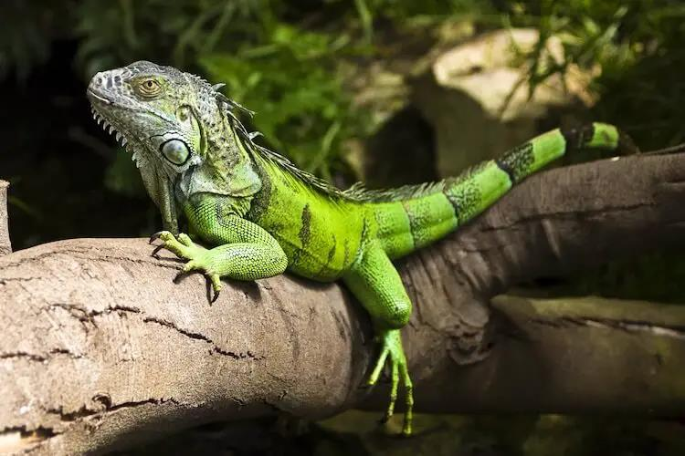

Slide 12
Caiman Lizard (Dracaena guianensis)
The Caiman Lizard (Dracaena guianensis) is a captivating reptile native to South America. It is welladapted to a semiaquatic lifestyle and plays a vital role in controlling aquatic vegetation. However, it faces threats such as habitat destruction and illegal trade, making conservation efforts crucial.

Slide 13
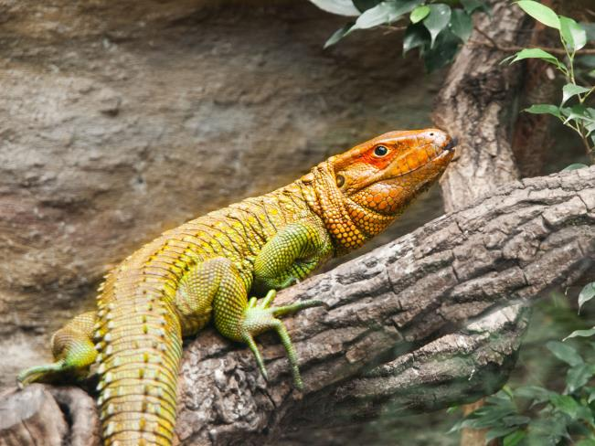

Slide 14
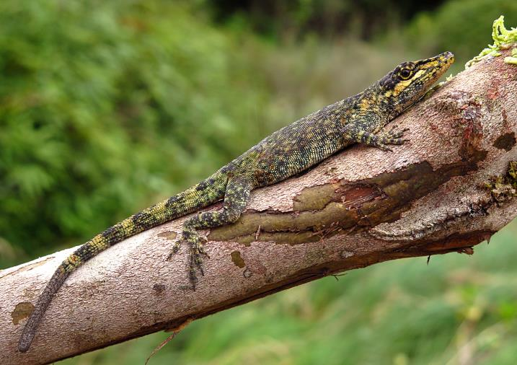

Slide 15
Tepui Lizard (Pristidactylus urichi)
South America is home to a diverse array of lizards, including the Green Iguana, Caiman Lizard, and Tepui Lizard. Each species plays a unique ecological role within its respective habitat, contributing to the overall balance and health of the ecosystem. However, they face various threats, such as habitat loss, climate change, and illegal trade, which necessitate urgent conservation efforts.

